Slide 1

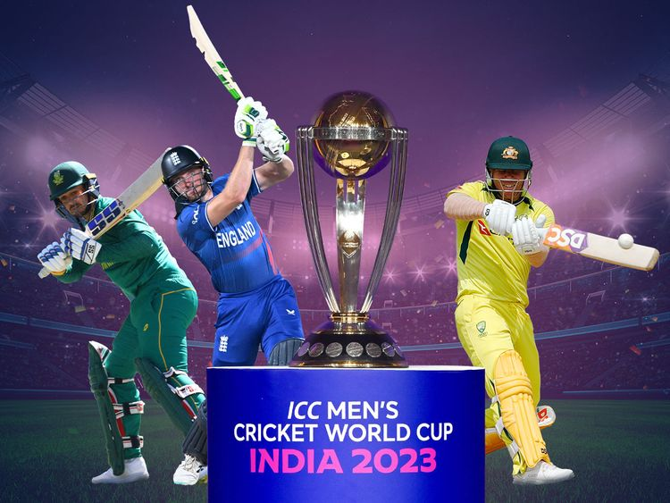
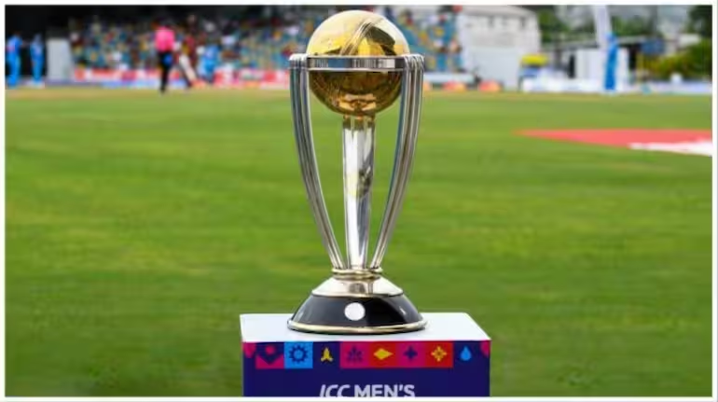

WORLD CUP 2023 ANALYSIS
By Mrunalini Yeole

Slide 2

Description
The Random Forest algorithm, a machine learning technique, is utilized to forecast the winner of the 2023 Cricket World Cup. This method scrutinizes diverse cricket-related data, encompassing team past performances, individual player statistics, prevailing pitch conditions, and additional relevant factors. By amalgamating insights from numerous decision trees, the algorithm refines its predictive accuracy, enabling it to offer informed speculations on the tournament's outcome. This approach not only aids cricket enthusiasts in anticipating the potential champion but also assists analysts in gaining deeper insights into the dynamics of the tournament.

Slide 3

Goals
Objective 01
To forecast the tournament's winner with a high degree of accuracy, based on historical and current data.
Objective 02
To analyze various cricket-related data, including team performance, player statistics.
Objective 03
To identify and evaluate the most influential factors affecting a team's chances of winning, helping teams and analysts focus on critical aspects.
Objective 04
Additionally, predict the results of individual matches throughout the entire tournament.
Objective 05
Conduct simulations for upcoming matches, specifically the semi-finals and finals.

Slide 4

Dataset
Tools
Here, I have collected datasets from github. In total I have used four datasets for the analysis and prediction. The first dataset named ‘World_cup_2023’ consists of the the team names and their winning and lossing percentage and also the ratings of the match. Then, second dataset named ‘results’ consist of the information about the winner team among the two team. The third dataset named ‘Fixtures’ consists of the team information and the last dataset used is ‘ ICC_ranking’ which comprises of the rank and the rating of the match.
Google Colab
Numpy
Pandas
Seaborn
Matplotlib
Scikit-learn

Slide 5

Data Preprocessing
01
describe() :
to give the statistical summary of the dataset
info():
it gives the overall information about the datasets including the all the columns.
02
03
isnull().sum() :
it check is there are any null values in the dataset
shape() :
is gives the total number of rows and columns in the dataset.
04

Slide 6


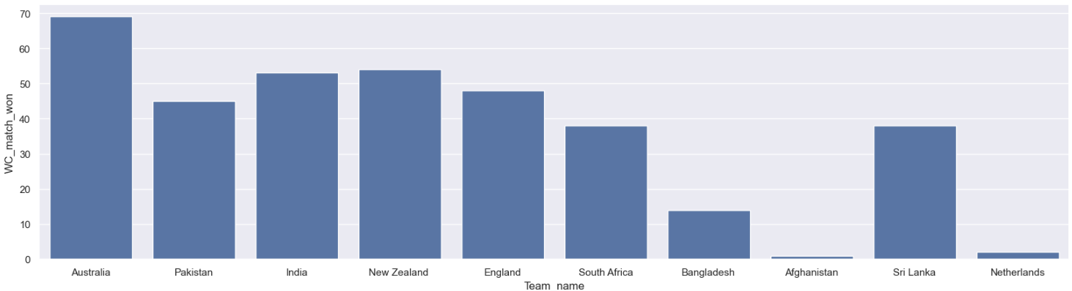
Exploratory Data Analysis
No. of matches won by each team

Slide 7
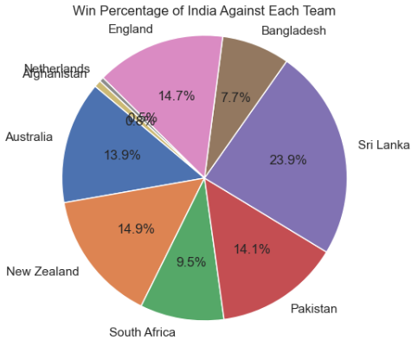
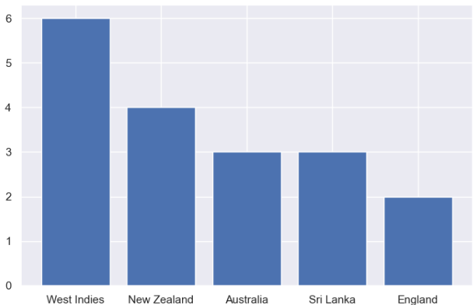
Statistics of some top team in ODI World cup 2023
Statistics of India team

Slide 8
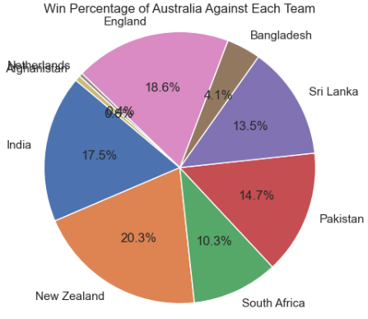
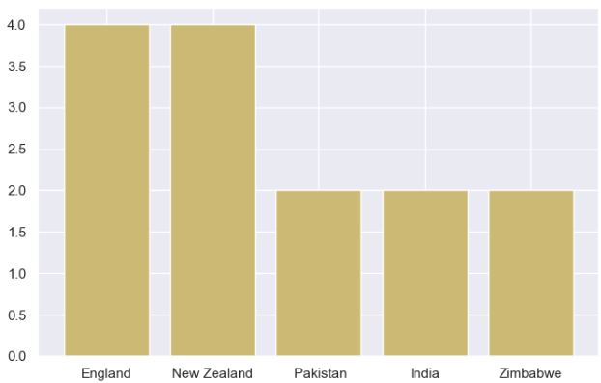
Statistics of some top team in ODI World cup 2023
Statistics of Australia team

Slide 9
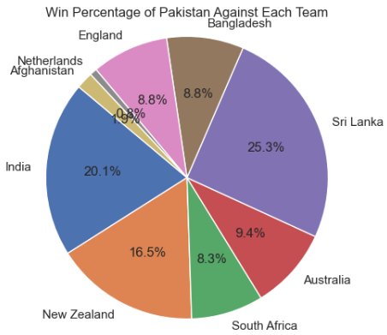
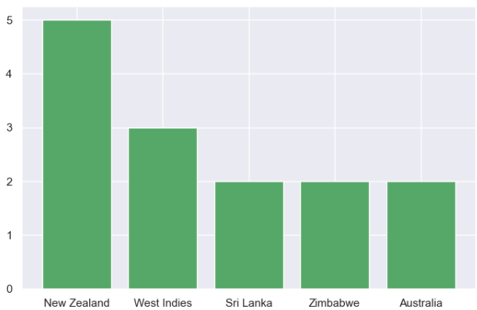
Statistics of some top team in ODI World cup 2023
Statistics of Pakistan team

Slide 10
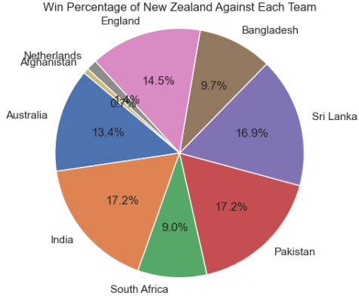
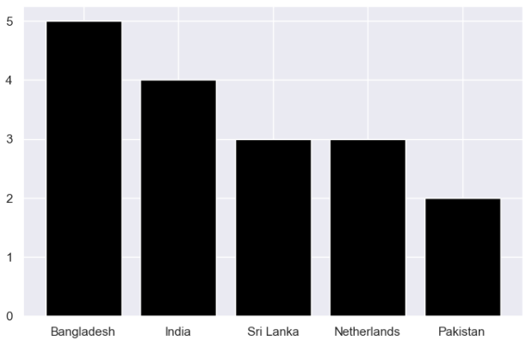
Statistics of some top team in ODI World cup 2023
Statistics of New Zealand team

Slide 11
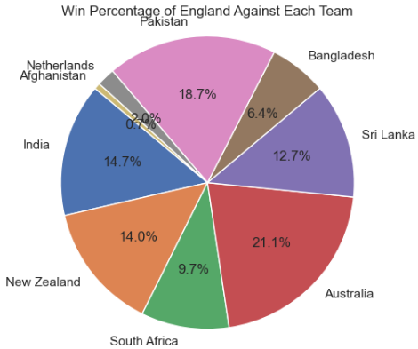
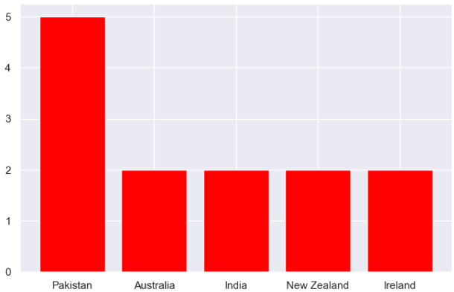
Statistics of some top team in ODI World cup 2023
Statistics of England team

Slide 12


Model Building
In the World Cup 2023 analysis prediction project, the Random Forest algorithm played a crucial role in predicting match outcomes and analyzing player performance. Random Forest is a machine learning technique that operates by constructing a multitude of decision trees during training and outputs the mode of the classes (classification) or mean prediction (regression) of the individual trees. In this project, historical match data, player statistics, team strategies, and other relevant factors were fed into the algorithm to train it to predict match results. The algorithm's ability to handle large datasets, handle categorical and numerical data, and reduce overfitting made it a suitable choice for this task. By leveraging Random Forest, analysts were able to generate accurate predictions for World Cup matches, providing valuable insights for teams, fans, and stakeholders alike.
RANDOM FOREST

Slide 13
Result And Discussion
In the comprehensive analysis of the World Cup 2023, the Random Forest algorithm emerged as the standout performer, showcasing remarkable accuracy rates. With a training accuracy of 74.9% and a test accuracy of 67.3%, it demonstrated robust predictive capabilities that significantly influenced tournament predictions. Delving deeper into the outcomes generated by this model, it notably highlighted India as a frontrunner with a higher likelihood of clinching the World Cup title.
Accuracy of training data
74.9%
Accuracy of testing data
67.3%

Slide 14

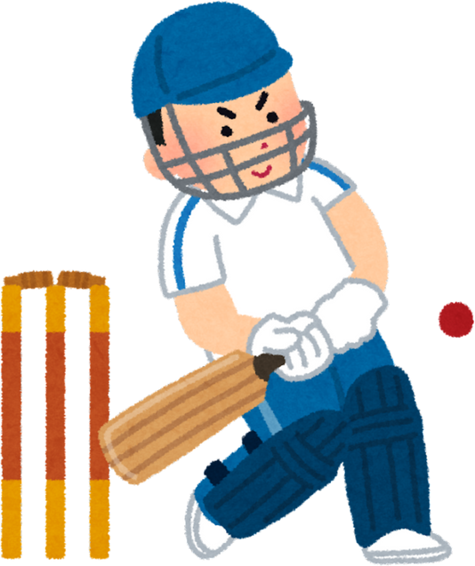

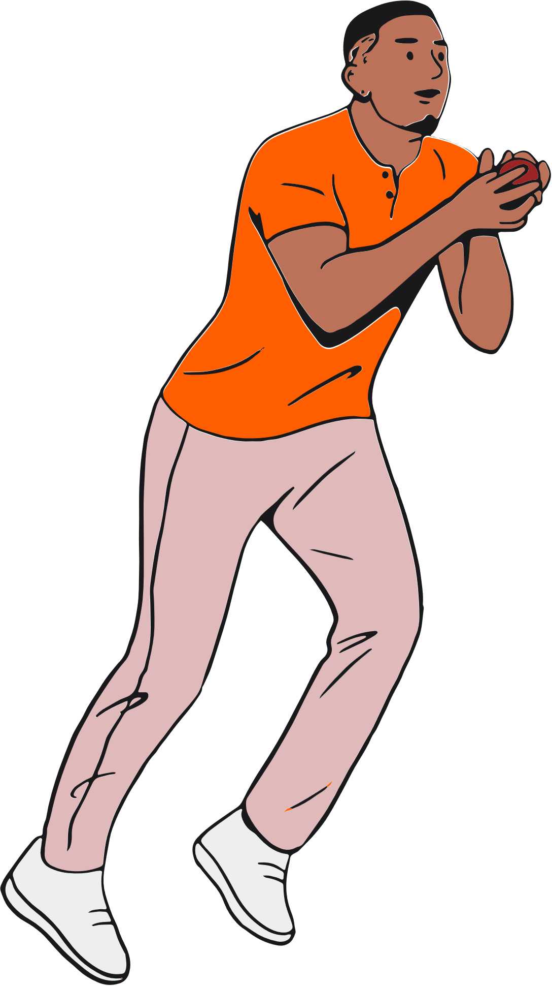
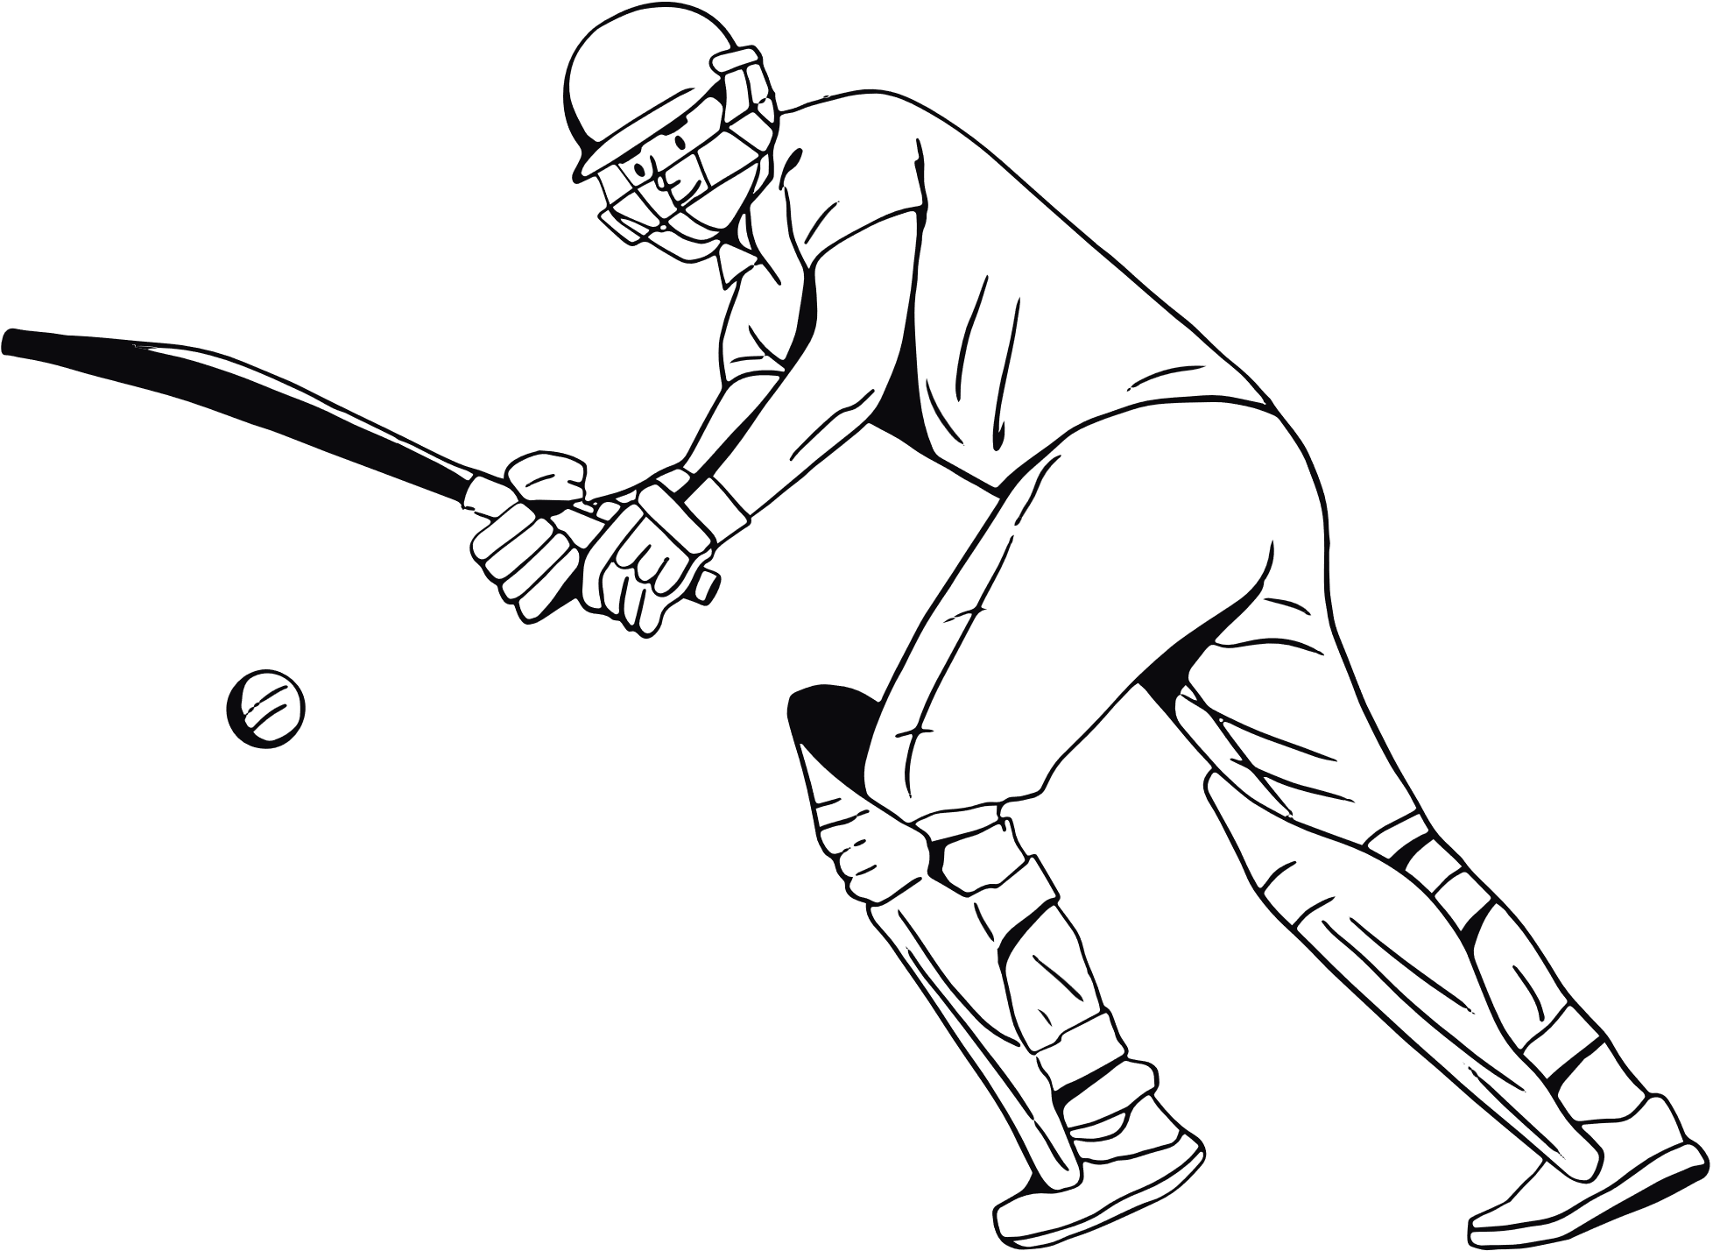
THANK YOU

